Slide 1

SLIDE 1
Team Name : Matrix
2. Members Name and Phone Numbers ROSHINI R S (leader’s name ) - 9842737254
3. Domain name: Wearable Technology
4. Problem statement: Wearable technology in health care

Slide 2
SLIDE 2
ABSTRACT
Wearable technology can be progressive answers for healthcare problems. Some wearable era applications are designed to prevent diseases and maintain health, together with weight control and physical hobby tracking. Wearable gadgets are also used for patient management and sickness management. The wearable packages can without delay affect clinical decision-making. Some believe that wearable technology could enhance the exceptional of affected person care while lowering the fee of care, such as patient rehabilitation outside of hospitals. The big information generated via wearable gadgets is both a mission and a possibility for researchers who can follow extra artificial intelligence (AI) techniques on those facts within the future. Most wearable technologies are nevertheless of their prototype levels. Issues including user attractiveness, safety, ethics, and large statistics issues in wearable technology nevertheless need to be addressed to enhance the usability and functions of these gadgets for realistic use.

Slide 3
SLIDE 3
NOVELTY
Wearable technology may be the revolutionary solution for healthcare troubles. In this examination, we performed a literature evaluation of wearable generation packages in healthcare. Some wearable era applications are designed for the prevention of illnesses and protection of health, consisting of weight manipulate and physical activity tracking. Wearable gadgets also are used for patient control and ailment management. The wearable applications can immediately impact clinical choice-making. Some consider that wearable technologies could enhance the satisfaction of patient care even by reducing the cost of care, which includes affected person rehabilitation outdoor of hospitals. The huge records generated via wearable gadgets is each a project and possibility for researchers who can observe more AI strategies on that data in the future

Slide 4
SLIDE 4
TECHNOLOGY STACK
Tracking physical sports the use of wearable devices has grown to be a famous method to help people determine hobby depth and calories expended. There is a developing hobby among fitness consumers to use wearable devices, especially patron wearable devices, to song weight manipulate sports and outcomes. A have a look at by using Dooley, Golaszewski, & Bartholomew (2017) in comparison and tested 3 predominant client devices for measuring workout intensities. The examine gadgets included Fitbit Charge HR, Apple Watch, and Garmin Forerunner 225. The task enrolled 62 members aged 18-38 and measured their heart costs and energy costs with the use of all 3 gadgets. A hypothetical ideal "gold general" test had a sensitivity of a hundred% and a specificity of 100%. The study confirmed an excessive significance of errors across all gadgets whilst compared to the gold trendy. This examination indicated that these gadgets are probably beneficial as a stimulus to growth pastime, however, they have obstacles as a monitoring and outcome dimension technique.

Slide 5
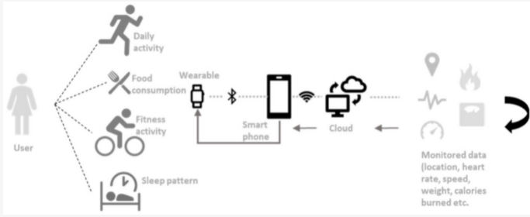
SLIDE 5
HARDWARE / SOFTWARE IMPLEMENTATION

Slide 6
SLIDE 6
BUSINESS SCOPE
Wearable gadgets themselves can provide crude comments like reminders to transport or stand which activates customers to take greater steps in line with an hour or stand more regularly. For extra charges, a few gadgets can offer greater targeted personal wellbeing reviews, presenting actionable guidance and coaching to help customers acquire their health and health goals. Some groups like Fitbit are taking it a step in addition and providing non-public, one-on-one coaching services for weight loss and diabetes control offering customers a personalized plan and direct assist from their group of licensed health and wellness coaches.

Slide 7
CONCLUSION
To summarize the consequences of the literature overview, the wearable era packages are grouped into 3 classes based totally on their roles. For example, wearable gadgets designed for weight management and physical pastime monitoring are listed within the phase of prevention of illnesses and renovation of fitness. In addition, there are sections of affected person control and disorder management.

Slide 8
REFERANCE
https://www.himss.org/resources/wearable-technology-applications-healthcare-literature-review
https://www.ncbi.nlm.nih.gov/pmc/articles/PMC7275133/
https://www.mdpi.com/1424-8220/19/9/1983/htm

